Slide 1
Gesture Remote Control
ECE 4180 - Final Project
Project link: https://developer.mbed.org/users/sjackson64/notebook/gesture-remote-control/

Slide 2
Team members
Tue Tran (Section A)
Carden Bagwell (Section B)
Sam Jackson (Section B)

Slide 3
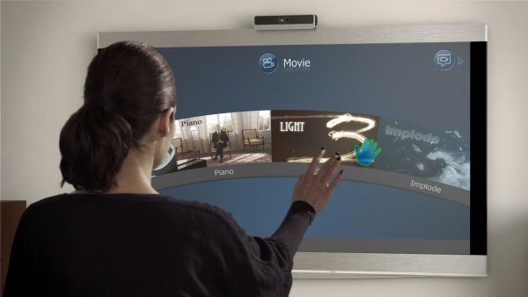
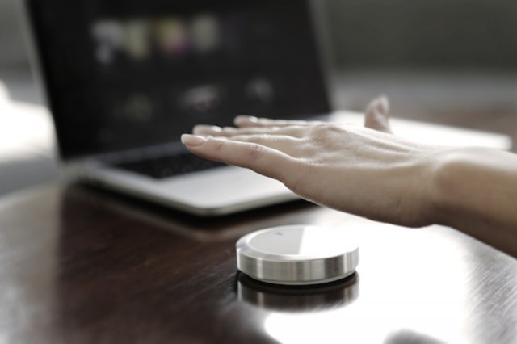
Motivation
Using hand gesture to control TV or Set-top box
Channel control
Volume control
Power (on/off)

Slide 4
Solution
Use the Gesture Sensor to select modes (Power, Channel, and Volume)
Hold hand above the Gesture Sensor for 3 seconds to send Power signal
Hold hand above the Ultra-sonic Ranger in Channel mode for channel up and down
Hold hand above the Ultra-sonic Ranger in Volume mode for volume up and down

Slide 5
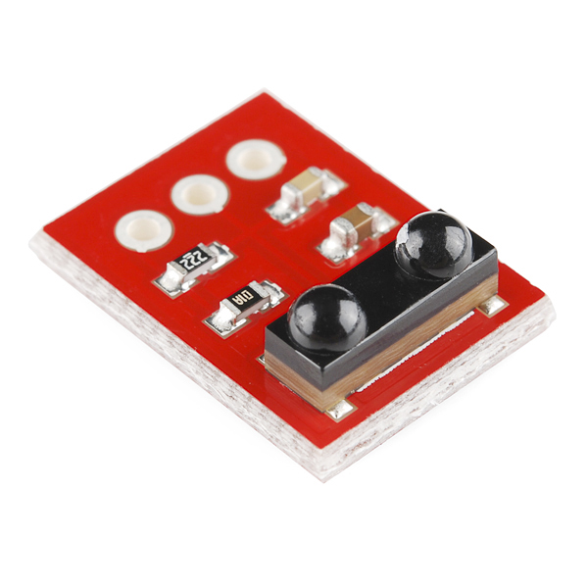
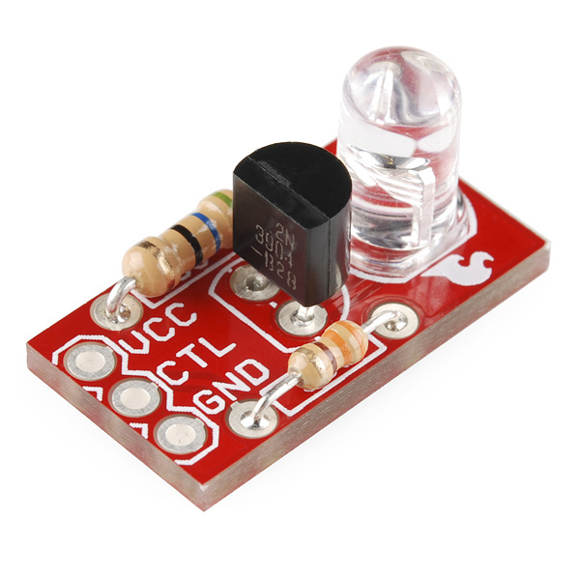
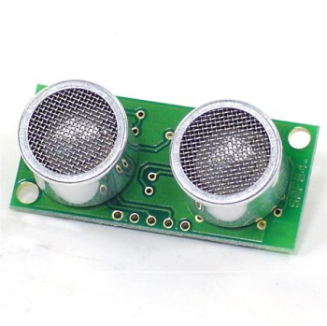
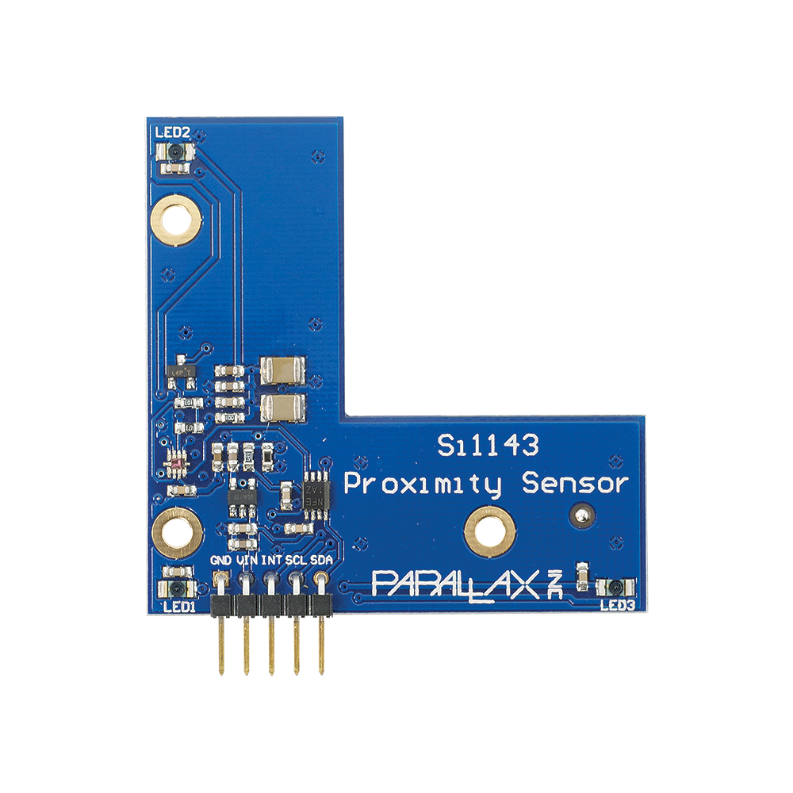
Parts
mbed NXP LPC1768
SparkFun IR receiver TSOP85
https://www.sparkfun.com/products/8554
SparkFun Power IR LED
https://www.sparkfun.com/products/retired/10732
Parallax Si1143 Gesture Sensor
https://www.parallax.com/product/28046
Polaroid Ultrasonic Ranger SRF04
http://www.robot-electronics.co.uk/htm/srf04tech.htm

